Slide 1
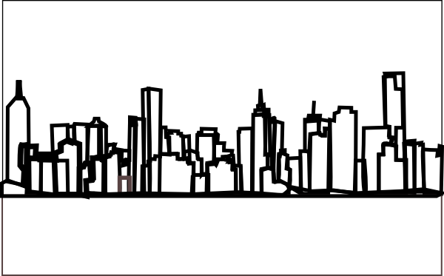
Urbanisation
http://www.clker.com/clipart-skyline-15.html

Slide 2
What is urbanisation?
It is the process of change in which an increasing proportion of the population live in urban areas.
E.g. Urban growth occurs as people move from rural areas to urban areas

Slide 3
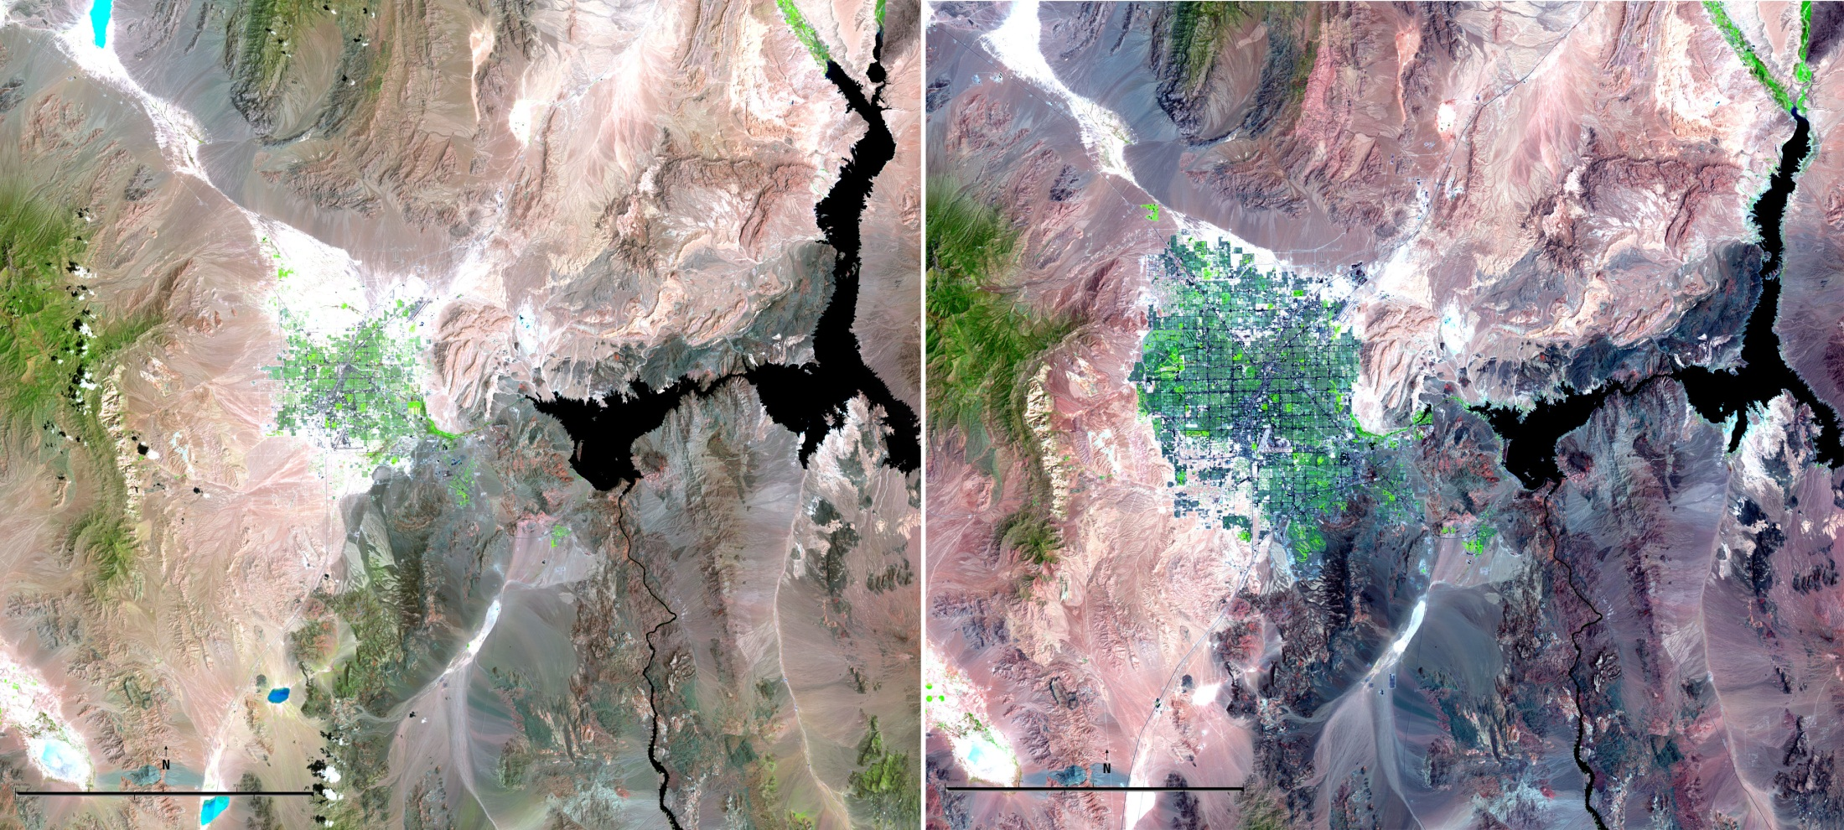
Example of urban growth: Las Vegas 1984 to 2011
In this image buildings are shown as green. Notice the increase in area that the city covers.
What do you notice about the size of the lake next to the city?
USGS, http://landsat.usgs.gov/images/gallery/103_L.jpg

Slide 4
Why people move from rural areas to urban areas
PUSH FACTORS
Factors that cause people to leave rural areas, such as:
Environmental issues: flood, drought, bushfires
Social factors: lack of employment and services such as medical care and education
PULL FACTORS
Factors that attract people to urban areas, such as:
Social factors: job opportunities, greater access to services such as medical care, education and transport, cultural and entertainment attractions.

Slide 5
How does urban growth influence the human characteristics of urban places?
The human characteristics of urban places change because there are greater numbers of people.
More services (e.g. doctors, telecommunications) are required
More goods (e.g. food and machinery) are required, so production increases
More built elements (houses, roads) are constructed
Diversity of communities is increased

Slide 6
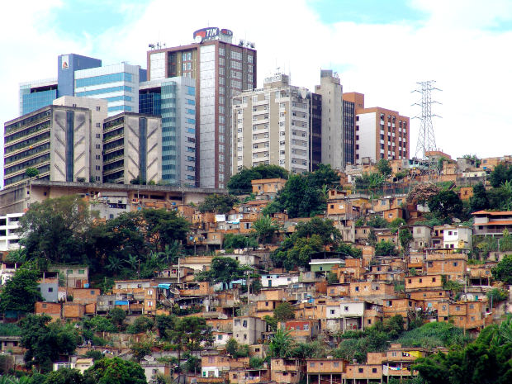
Growth of urban areas
Urban areas can be planned or unplanned.
In Australia, most building is planned/approved by local governments based on zones (areas) that define their use.
In some countries, cities are not planned and grow unchecked.
Favela in Brazil – Unplanned slums in front of wealthy apartment blocks. http://www.morguefile.com/archive/display/59042

Slide 7
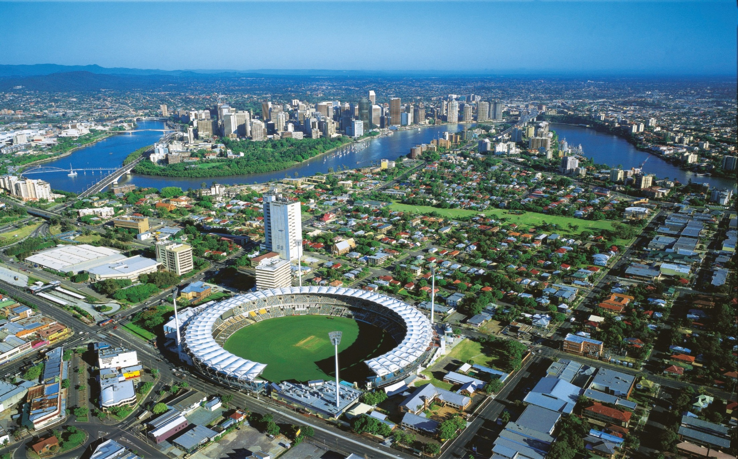
How do major urban places grow?
Outer/fringe suburbs
CBD
Inner suburbs
In major cities an urban area grows around a central business district (CBD) which often has many high rises with apartments and business. Suburbs and outer suburbs and fringe areas surround the CBD and are connected by roads. They often have houses or smaller apartment blocks.
Courtesy of Tourism and Events Queensland
http://teq.lookat.me.com.au/items/tq/preview/110/tq1106796P.jpg

Slide 8
Attributions
Slide 1 - http://www.clker.com/clipart-skyline-15.html
Slide 3 – USGS, http://landsat.usgs.gov/images/gallery/103_L.jpg
Slide 6 - http://www.morguefile.com/archive/display/59042
Slide 7 - Courtesy of Tourism and Events Queensland http://teq.lookat.me.com.au/items/tq/preview/110/tq1106796P.jpg

