Slide 1
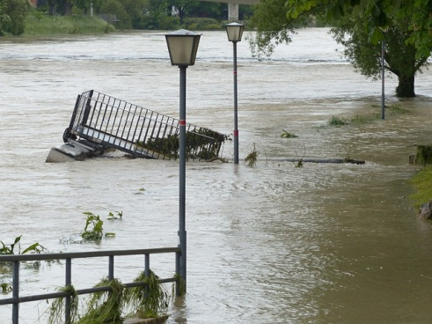
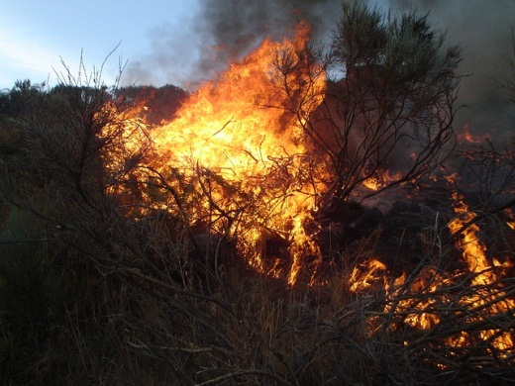
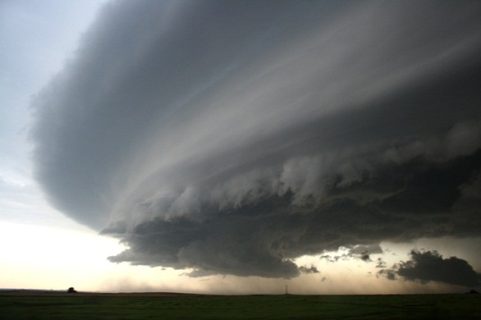
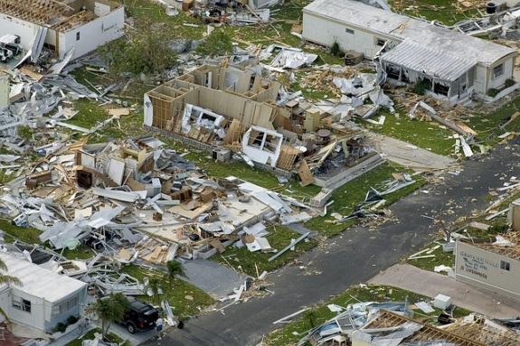
Natural hazards

Slide 2
When hazards become disasters
Natural hazards are severe and extreme events that occur as part of natural processes.
Natural hazards become natural disasters when people’s lives and properties are destroyed.

Slide 3
Queensland at risk
Queensland is prone to the following hazards:
Flooding
Cyclones
Bushfires
Severe storms
Each of these has the potential to become disastrous under certain conditions

Slide 4
Floods
http://pixabay.com/en/high-water-street-gone-down-damage-123220/

Slide 5
Cyclones
http://pixabay.com/en/key-west-florida-hurricane-dennis-86025/

Slide 6
Bushfires
http://pixabay.com/en/fire-flames-orange-107080/

Slide 7
Severe storms
http://pixabay.com/en/sky-clouds-super-cell-thunderstorm-79938/

Slide 8
Classifying natural hazards
Geophysical (land) | Hydrological (water) | Climatological (climate) | Biological (living things)
earthquakes | floods | storms | diseases
landslides | avalanches | drought | animal plagues
sinkholes |  | cyclones
tsunamis |  | heat wave
 |  | bushfires

Slide 9
Using indigenous knowledge to prepare for natural hazards
Knowledge on disaster preparedness comes from local peoples’ observations of their lands over generations. Knowledge has been handed down through stories, paintings, songs, poems, ceremonies and rituals. Examples include:
Changes in animal behaviours
Changes in the appearance of the sky
Watching the size of waves to predict cyclones
Watching the flowering patterns of native plants
Moving between habitats as hazards strike

Slide 10
Attributions
Slides 4-7
http://pixabay.com/en/high-water-street-gone-down-damage-123220/
http://pixabay.com/en/key-west-florida-hurricane-dennis-86025/
http://pixabay.com/en/fire-flames-orange-107080/
http://pixabay.com/en/sky-clouds-super-cell-thunderstorm-79938/

