Slide 1
Human characteristics

Slide 2
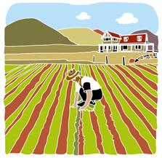
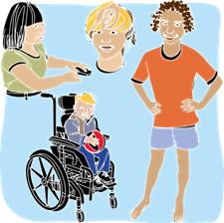
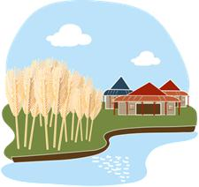
Human characteristics of places
Human characteristics
people
production
buildings
communities and culture
All images © DETE

Slide 3
A comparison of the human characteristics of rural and urban places
Rural
Reduced population
Urban
Increased population
Less streets
More space between houses and businesses
Less options for services (stores, hospitals, banks)
Moderate impact of built environment on natural features
Large road networks
Homes and business are often closer together
Many options for shopping and services
Significant impact of built environment on natural features

Slide 4
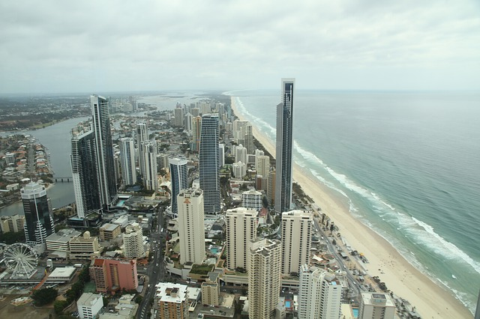
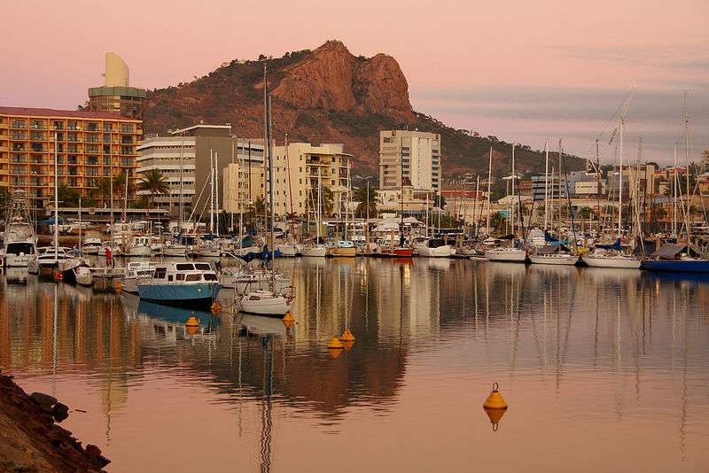
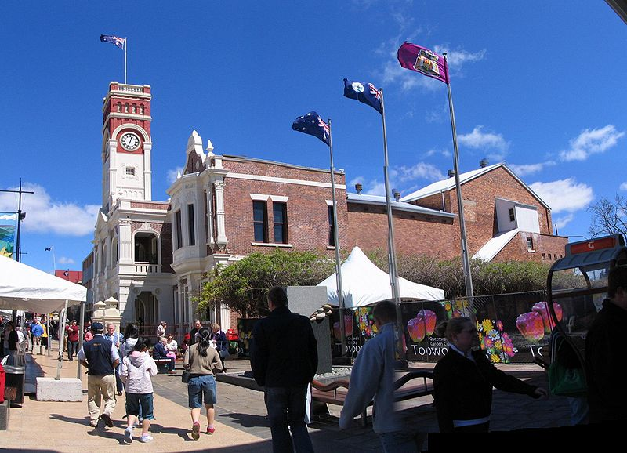
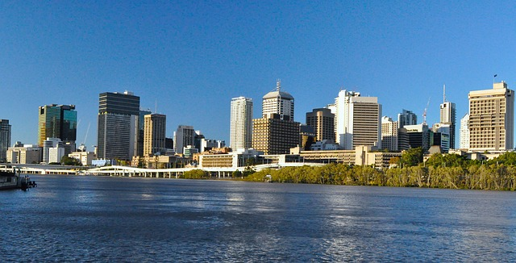
What are the human characteristics of these urban places?
http://pixabay.com/en/city-skyscraper-skyscrapers-185742/
http://commons.wikimedia.org/wiki/File:TownsvilleSkyline08.jpg
Foundationexpo88, http://commons.wikimedia.org/wiki/File:Toowoombagpo.jpg
CC BY 3.0 http://creativecommons.org/licenses/by/3.0/deed.en
http://pixabay.com/en/brisbane-city-river-queensland-164201/

Slide 5
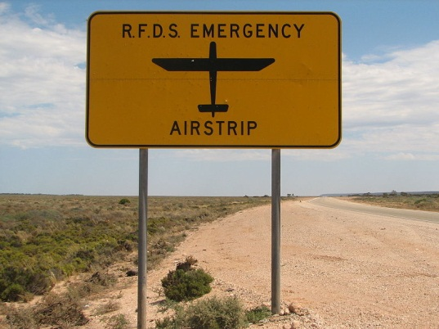
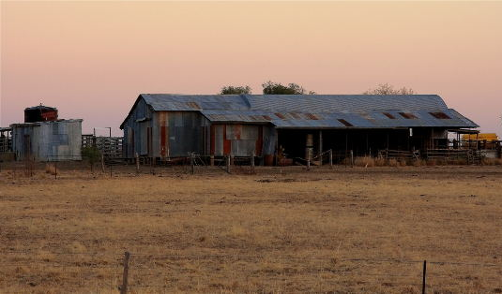
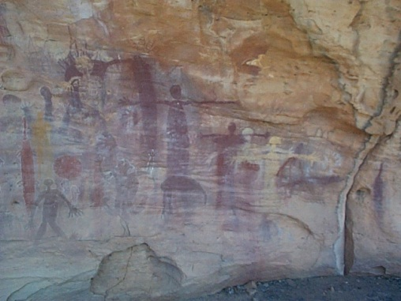
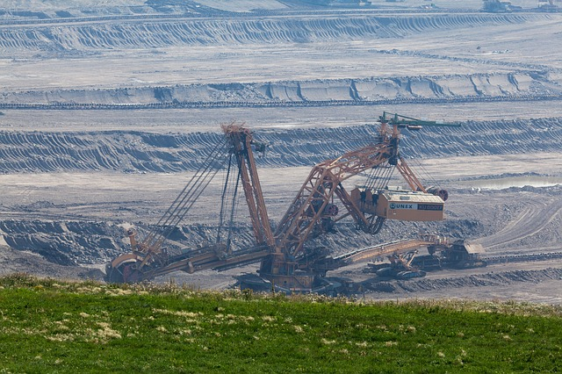
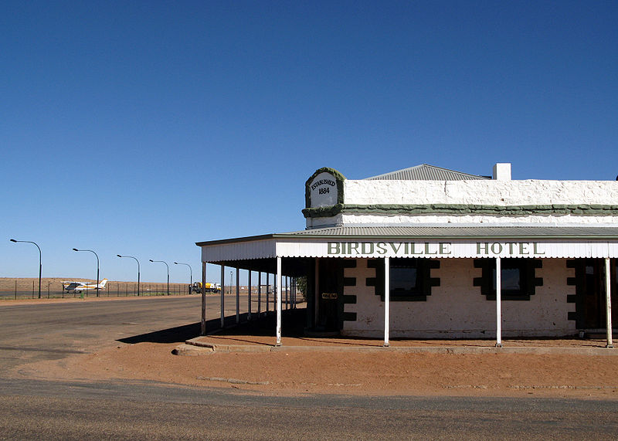
What are the human characteristics of these rural places?
http://commons.wikimedia.org/wiki/File:RFDS_emergency_landing_strip_sign.jpg
http://www.morguefile.com/archive/display/632865
http://commons.wikimedia.org/wiki/File:Quinkan1.jpg
http://pixabay.com/en/big-bucket-wheel-excavator-coal-71680
http://commons.wikimedia.org/wiki/File:Birdsville_Hotel.jpg

Slide 6
Attributions
Slide 4 -
http://pixabay.com/en/city-skyscraper-skyscrapers-185742
http://pixabay.com/en/brisbane-city-river-queensland-164201
http://commons.wikimedia.org/wiki/File:TownsvilleSkyline08.jpg
Foundationexpo88, http://commons.wikimedia.org/wiki/File:Toowoombagpo.jpg
CC BY 3.0 http://creativecommons.org/licenses/by/3.0/deed.en
Slide 5 -
http://commons.wikimedia.org/wiki/File:RFDS_emergency_landing_strip_sign.jpg
http://commons.wikimedia.org/wiki/File:Quinkan1.jpg
http://www.morguefile.com/archive/display/632865 http://commons.wikimedia.org/wiki/File:Birdsville_Hotel.jpg
http://pixabay.com/en/big-bucket-wheel-excavator-coal-71680

