Slide 1
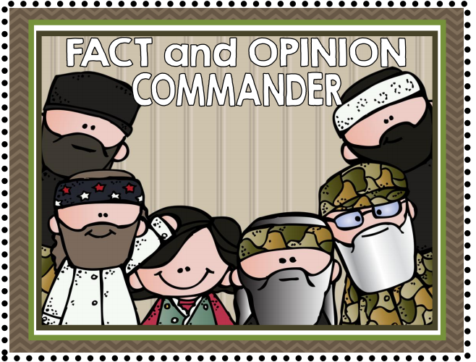

Slide 2
Watch this short clip….

Slide 3
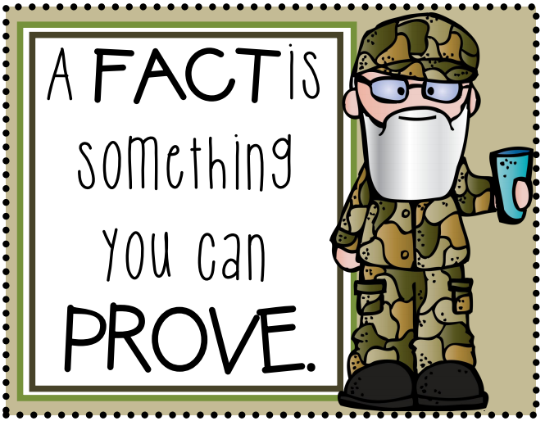
Clue 1

Slide 4
Clue 2

Slide 5
Fact or Opinion?

Slide 6
Fact or Opinion?

Slide 7
Fact or Opinion?

