Slide 1
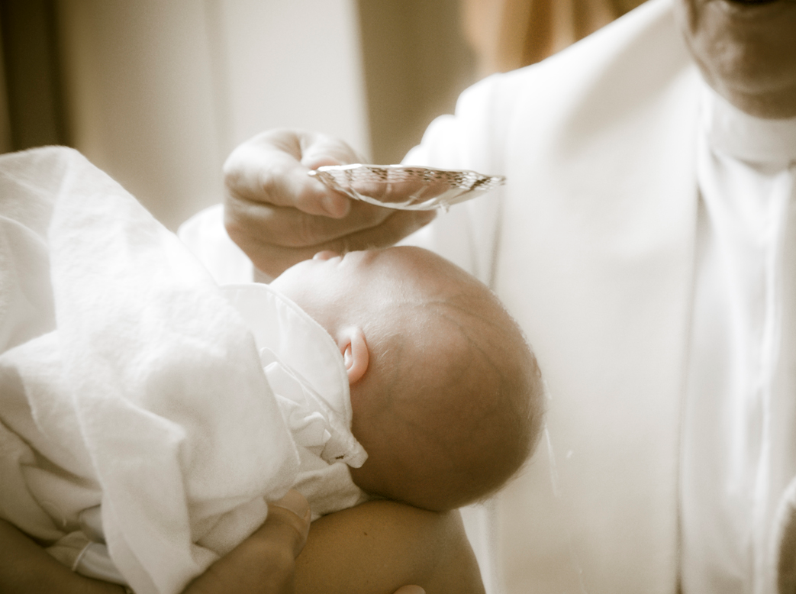

Slide 2
Who has been baptised and what do you know about it?

Slide 3
As you watch the following two baptisms, what do you notice?

Slide 4
Notes:
Videos of Lutheran Baptism

Slide 5
Notes:
Videos of Lutheran Baptism

Slide 6
A tattooed pastor’s perspective

Slide 8
For Lutherans, baptism is about God coming to us and it normally takes place in the context of a worship service

Slide 9
Baptism is Sacramental
A Sacrament is…
A spiritual mystery that uses both an element and God’s word – God coming to us
What is the element?
What is the Word?
Notes:
Explain that mum/dad might say that they love you… but how do you now for sure?

Slide 10
¹⁹ Therefore, go and make disciples of all the nations, baptizing them in the name of the Father and the Son and the Holy Spirit. ²⁰ Teach these new disciples to obey all the commands I have given you. And be sure of this: I am with you always, even to the end of the age.”
Matthew 28:19-20 New Living Translation (NLT)
Notes:
Emphasise the use of the word ‘Name’. What does it mean to do something in someone’s name?

Slide 11
¹⁹ Therefore, go and make disciples of all the nations, baptizing them in the name of the Father and the Son and the Holy Spirit. ²⁰ Teach these new disciples to obey all the commands I have given you. And be sure of this: I am with you always, even to the end of the age.”
Matthew 28:19-20 New Living Translation (NLT)
Notes:
Emphasise the use of the word ‘Name’. What does it mean to do something in someone’s name?

Slide 12
⁵ (God) saved us, not because of the righteous things we had done, but because of his mercy. He washed away our sins, giving us a new birth and new life through the Holy Spirit.
Titus 3:5 New Living Translation (NLT)
Notes:
A water bath… washing to give a new birth and new life

Slide 13
⁵ (God) saved us, not because of the righteous things we had done, but because of his mercy. He washed away our sins, giving us a new birth and new life through the Holy Spirit.
Titus 3:5 New Living Translation (NLT)
Notes:
A water bath… washing to give a new birth and new life

Slide 14
³⁸ Peter replied, “Each of you must repent of your sins and turn to God, and be baptized in the name of Jesus Christ for the forgiveness of your sins. Then you will receive the gift of the Holy Spirit. ³⁹ This promise is to you, to your children, and to those far away—all who have been called by the Lord our God.”
Acts 2:38-39 New Living Translation (NLT)
Notes:
Context: Acts 2 is the story of the Holy Spirit coming at Pentecost? What happened?
After the speaking in different languages and the tongues of fire, the Peter had the people’s attention. He spoke about Jesus, and about the fact that at this time amazing things would happen. He spoke about the fact they were responsible for Jesus’ death. Some of the people were really distressed, and they wanted to know what they could do about it. And Peter said (Acts 2:38-39)
Notice the key words

Slide 15
³⁸ Peter replied, “Each of you must repent of your sins and turn to God, and be baptized in the name of Jesus Christ for the forgiveness of your sins. Then you will receive the gift of the Holy Spirit. ³⁹ This promise is to you, to your children, and to those far away—all who have been called by the Lord our God.”
Acts 2:38-39 New Living Translation (NLT)
Notes:
Context: Acts 2 is the story of the Holy Spirit coming at Pentecost? What happened?
After the speaking in different languages and the tongues of fire, the Peter had the people’s attention. He spoke about Jesus, and about the fact that at this time amazing things would happen. He spoke about the fact they were responsible for Jesus’ death. Some of the people were really distressed, and they wanted to know what they could do about it. And Peter said (Acts 2:38-39)
Notice the key words
Baptism brought the gift of the Holy Spirit… and that gift is for you, your children and all people

Slide 16
³ Or have you forgotten that when we were joined with Christ Jesus in baptism, we joined him in his death? ⁴ For we died and were buried with Christ by baptism. And just as Christ was raised from the dead by the glorious power of the Father, now we also may live new lives.
Romans 6:3-4 New Living Translation (NLT)
Notes:
So what happens in Baptism?

Slide 17
³ Or have you forgotten that when we were joined with Christ Jesus in baptism, we joined him in his death? ⁴ For we died and were buried with Christ by baptism. And just as Christ was raised from the dead by the glorious power of the Father, now we also may live new lives.
Romans 6:3-4 New Living Translation (NLT)
Notes:
So what happens in Baptism?
We are united, made one with Jesus. When Jesus died, we died. When Jesus rose, we rose.
For what purpose – to live new lives
That’s the cool bit. Our baptism means that we don’t need to hold on to things that we have done wrong. We don’t need to live in the past. His story becomes our story.

Slide 18
¹² For you were buried with Christ when you were baptized. And with him you were raised to new life because you trusted the mighty power of God, who raised Christ from the dead.
Colossians 2:12 New Living Translation (NLT)
Notes:
It’s all about trust – trusting in what Jesus has done.

Slide 19
¹² For you were buried with Christ when you were baptized. And with him you were raised to new life because you trusted the mighty power of God, who raised Christ from the dead.
Colossians 2:12 New Living Translation (NLT)
Notes:
It’s all about trust – trusting in what Jesus has done.

Slide 20
Notes:
Video of trust walk

Slide 21
²¹ And that water is a picture of baptism, which now saves you, not by removing dirt from your body, but as a response to God from a clean conscience. It is effective because of the resurrection of Jesus Christ.
1 Peter 3:21 New Living Translation (NLT)
Notes:
So Baptism Saves

Slide 22
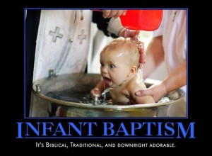

Slide 23
Is baptism about the water?
Is it about the Word?
It is a Sacrament, a mystery, God coming to us.
It is about both Word and water.
Notes:
So Baptism Saves

