Slide 1
5L Presents…. The Lord’s Prayer

Slide 2
Our Father who art in Heaven
Sam, Damien and Caleb 5L

Slide 4
Why do we pray to god ?
Because he answers our questions and our thoughts . Because there is only one God and that is our God.

Slide 5
Our father in heaven
It means when we die we have eternal life in heaven so we know that one day we will meet God because it tells you in the bible. If you believe in God you will go to heaven but if we don’t pray to God we will go to hell

Slide 6
Our father in heaven
This means
Our father in heaven means when we die we have internal life in heaven and you will have peace and quiet.

Slide 7
Why do people pray to god in different ways?
Because people might want to open there hands out or fold there hands while they say something about them.

Slide 8
What happens to God when people do something wrong?
If someone does something wrong he might get a bit up set.

Slide 10
Why is it so easy to put our trust in the things of this world and so difficult to put our trust in God? Is it because we can ‘see’ the things of this world, but we cannot physically see God? Every day, we have problems that are too hard for us to control so we struggle, but we still put trust in the world. Even though it is much better to trust God not the world.

Slide 11
Hallowed be your name
Frances and Shonagh 5L

Slide 12
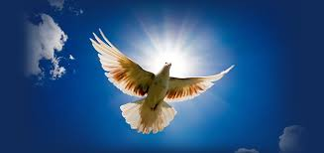
HALLOWED BE THY NAME
Shonagh Frances

Slide 13
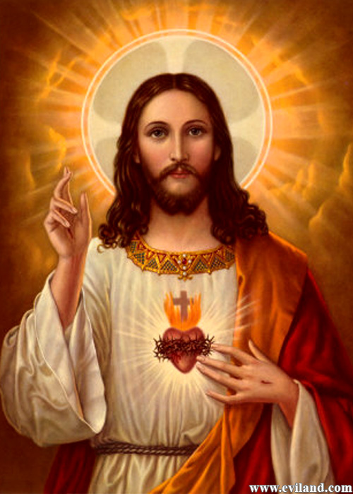
The word “holy” means…
Meaning that God is sacred, so God is important.

Slide 14
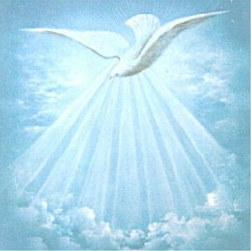
How you can show that Gods name is holy
not using gods name in vain and
praising or thanking god for all he does

Slide 15
People can show that God’s name is holy by… Don’t use his name is vain (a bad way)
Its easy to give God credit for the good things he has done. Its also is really easy to give God credit for the not so good things which have happened. If you do this you are using Gods name in a bad way which is very bad to do:
Don’t say this:
‘Oh my God’
That is using his name in vain
Instead Say:
‘No, but it’s ok

Slide 16
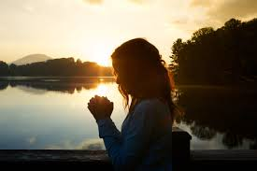
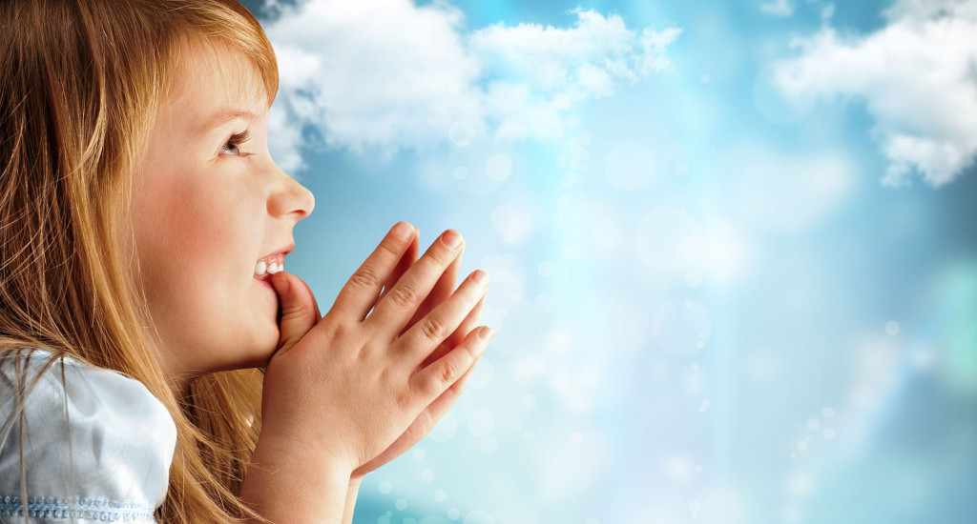
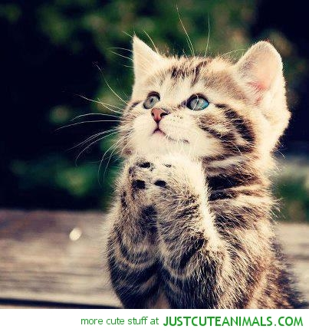
Pictures of ways you could praise God
A main one is:
PRAYING!

Slide 17
Your Kingdom come
Ella, Elsie and Charlotte 5L

Slide 18
Your Kingdom Come
By, Charlotte Roche, Elsie Long and Ella Bunn

Slide 19
Definition of Kingdom
Kingdom means the path with God through a journey to his kingdom which is heaven. Heaven is where God holds our future in a calm peaceful place with God.The kingdom is within you ,because Gods love is everywhere with you even through rough times. God will guide you through your journey.

Slide 20
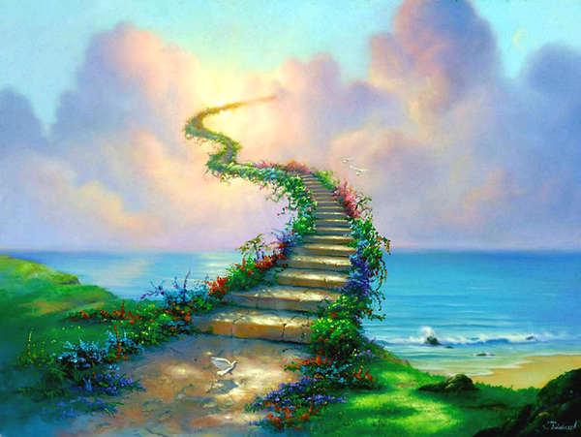
Why do we want Gods Kingdom to come?
We want Gods Kingdom to come because in Gods Kingdom (heaven) there is no sin or death and unfortunately on earth there are wars and fights and so we want Gods Kingdom to come.

Slide 21
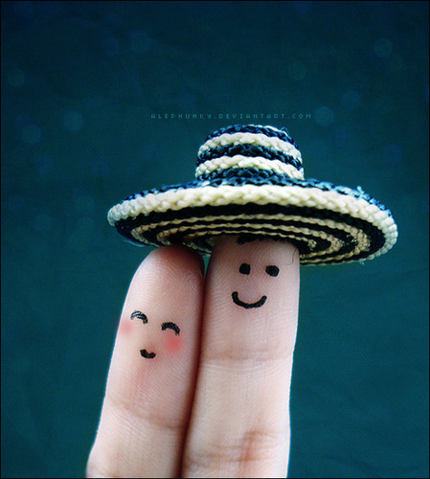
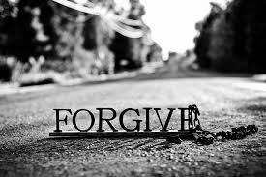
Forgiveness
God wants everyone in his kingdom even if they don’t believe in him, we want Gods kingdom to come to us in peace and hold us in his hands. We need God to forgive our sins and forget our wrongs.

Slide 22
Please stay quiet and enjoy this video
3:44-4:26
https://www.youtube.com/watch?v=E28xqYpupdM

Slide 23
Thank You For Listening!

Slide 24
Your will be done on Earth as it is in Heaven
Kai, Lachlan and Jaiveer 5L

Slide 26
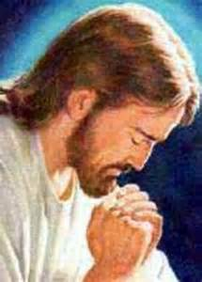
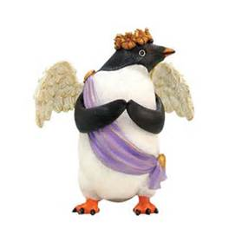
God wants us to believe in him and to follow his rule so we will have eternal life in heaven.

Slide 27
A lady is discussing what ‘your will be done on earth as in heaven’ means.
https://www.youtube.com/watch?v=gG4KUd_GyHE
Timing-
1:50-2:15

Slide 28
Gods will
Your will be done on Earth as in Heaven. This means God’s will is us being saved from sin and following his directions. If you believe you will have eternal life in Heaven. God sent down Jesus so he could die for us and take away our sins and save us

Slide 29
God’s will
God wants us to come and know the truth, he wants us to know the sacrifice Jesus Christ ( His one and only son) made. Jesus died to take away our sins and to give us a clean start again. It is like a canvas you can start again. If you believe in him you will have eternal life.

Slide 30
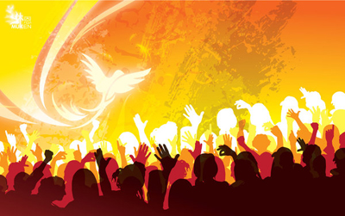
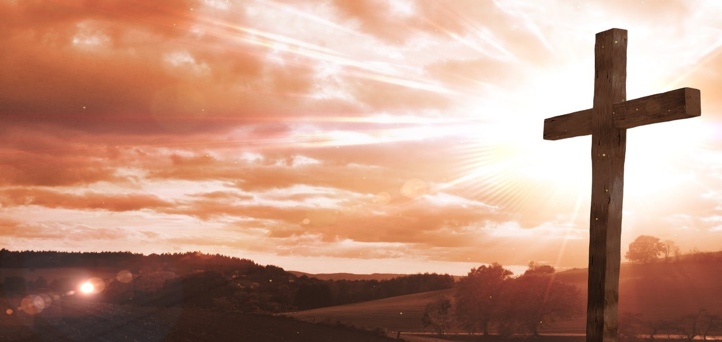
1 timothy 2:4-5
“he wants everyone to be saved . He wants them to come to know the truth.
This verse means that he wants everyone on earth to believe in him and to know the sacrifice Jesus made. If you do believe and follow gods rules you will live eternally in heaven and your sins will be forgiven.

Slide 31
Thank you for listening and have a great day!!!

Slide 32
Give us today our daily bread
Zane, Mitchell and Sebastian 5L

Slide 33
This is a power point presentation on our Section of the lords prayer.

Slide 34
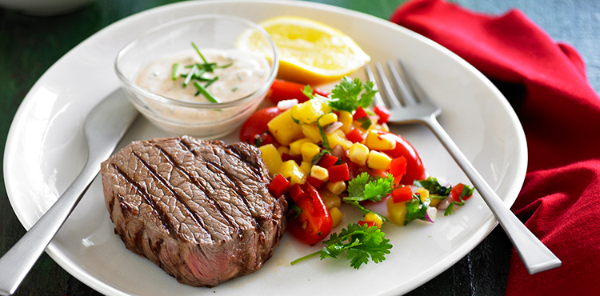
What does the Daily Bread mean to me?
The daily bread means a normal and healthy meal a day.
Also the money or food that one needs order to live.

Slide 35
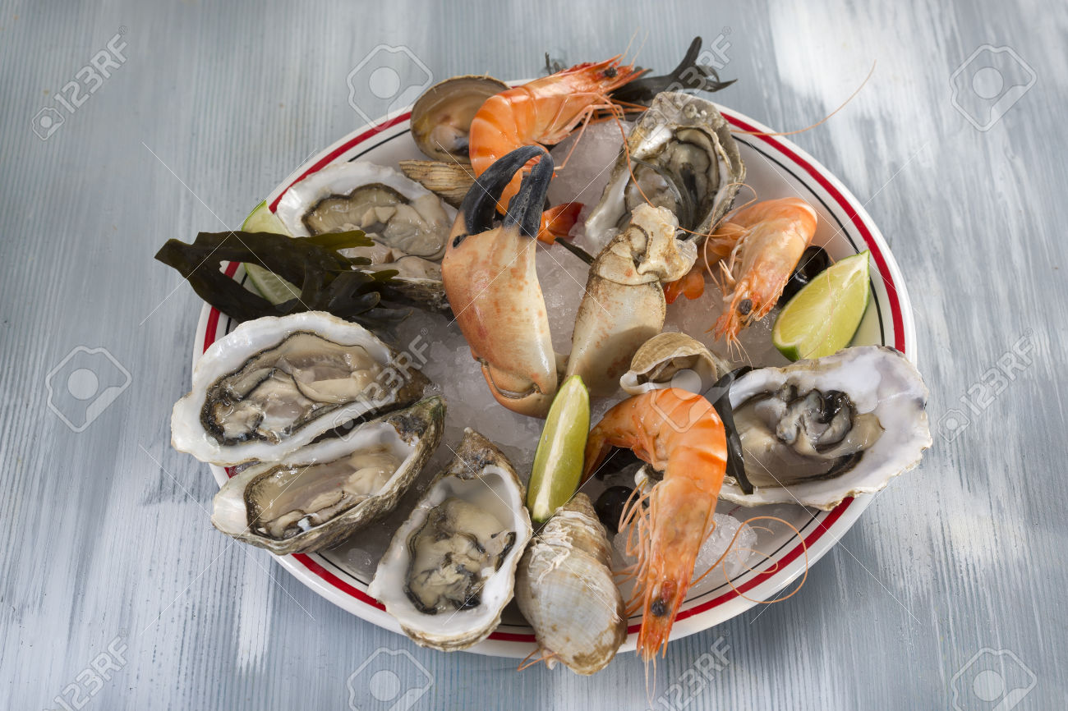
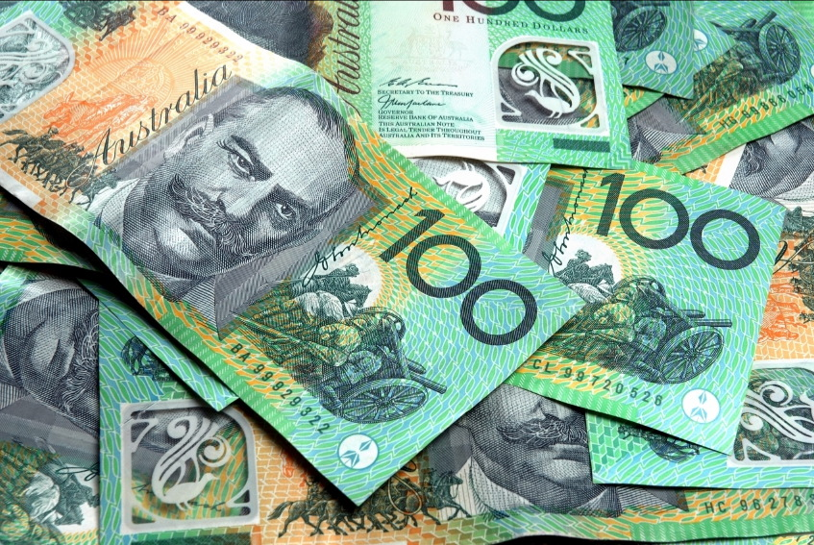
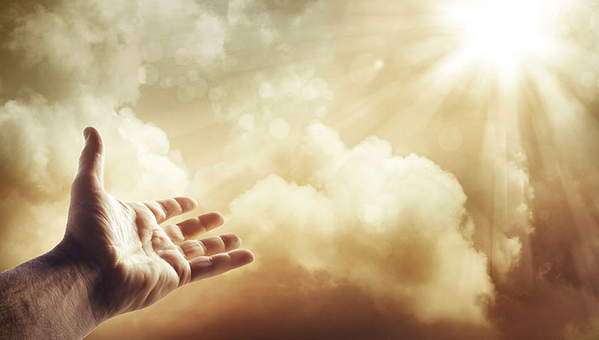
What daily bread can you be thankful for today?
My group and I believe that you can be thankful for the things you need to live such as
Food, money, joy and God

Slide 36
1st part of daily bread speech
God gives us daily bread to all people, whether they are good or bad, even if we don’t ask this to happen. But in this prayer we are asking: “Father, help us to see our daily bread as your gift, and to be thankful for it.”Daily bread actually means everything that we need for our life.

Slide 37
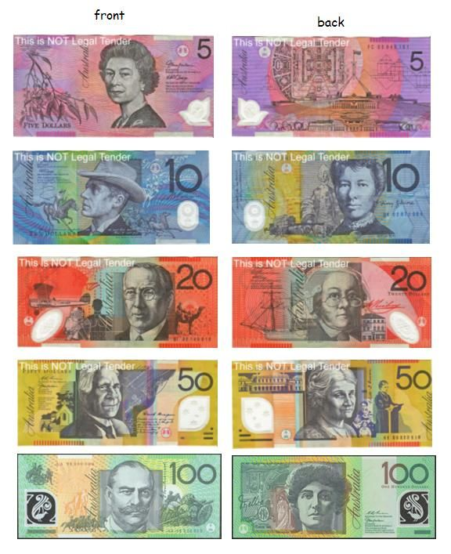
Speech part 2
For example : food , clothes , a place to live , money and possessions a good marriage , loving children ,good people to work with ,good and honest community leaders , good government, good weather , peace , health , respect for the law , a good reputation , good friends and helpful neighbours.

Slide 38
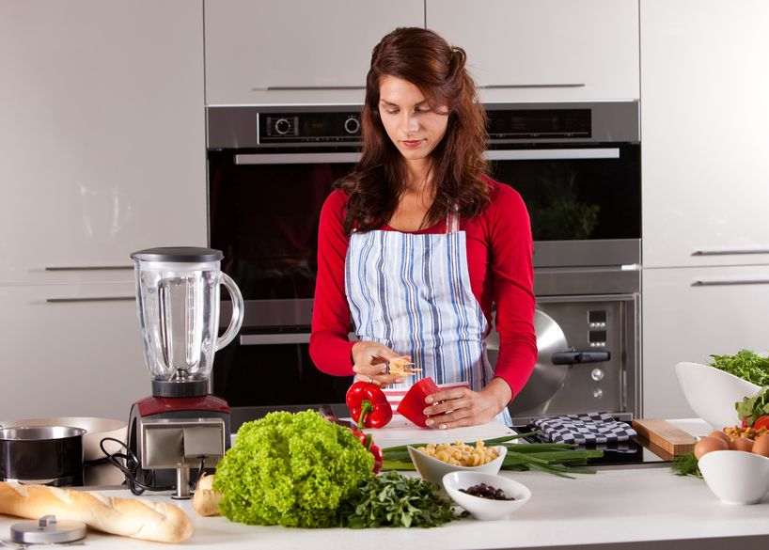
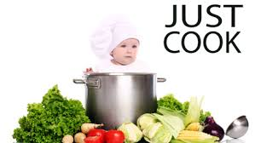
what are some ways people can help give “daily bread” to others ?
We can cook food for others and also give food to others that are poor and homeless .We can also give food away to charity's and donations like meals for you and other food charity's.

Slide 39
Thankyou
Thankyou for listening to our interpretation on this part of the lords prayer.
By Zane, Seb and Mitch

Slide 40
Forgive us our sins as we forgive those who sin against us
Madisyn, Eliza and Neave

Slide 41
Our part of the lords prayer
By Madi, Neave and Eliza

Slide 42
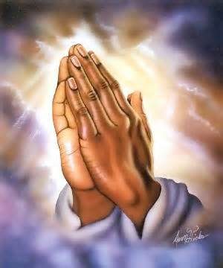
This is my part of the lords pray by Eliza.
I think that we should not pray for the things we wont because people on the other side of the country or somewhere in the world for away that don’t even have covering for there family or friends and have to live under trees and wood some of them are even lucky to have tine as there shelter some only get one meal a day when we get great roofs and shelter food we love and get really cool gams so think about the fact that we have a lot more things then most people have.
We don’t deserve anything we pray for. We sin every day and all we deserve is punishment.

Slide 43
My part of the lords prayer. By Madi.
I think that my part of the lords prayer means that you don’t ignore our prayers.
You forgive our sins and we will forgive the people who sin against us.
You never ignore anything we ask you because you are so kind.
It means that you don’t ever ignore anything even when people sin.
"father, do not look at our sins or refuse to listen to our prayer because of them instead, give us everything we need simply out of your kindness.

Slide 44
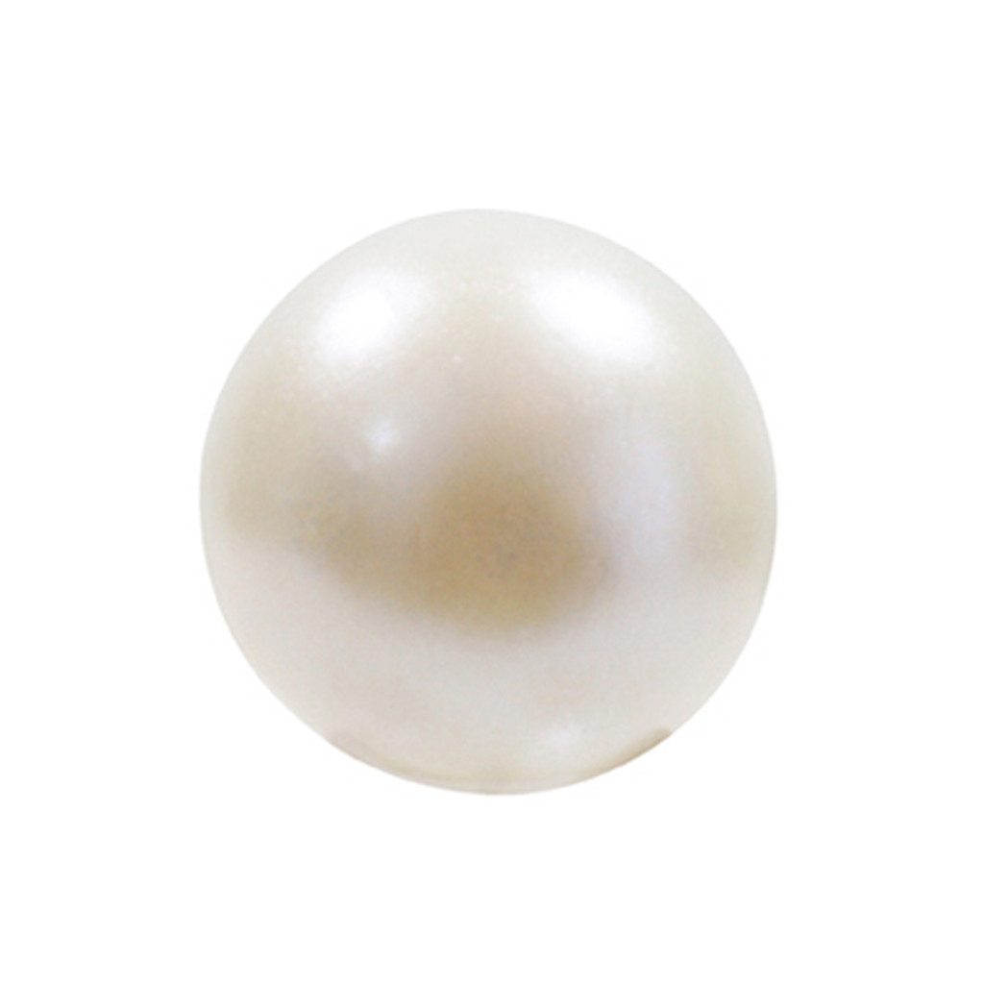
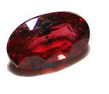
My part of the lords prayer by Neave.
What I think this means is we be kind and forgive them even though they have hurt us in some way.
You could show this to other people and god will be pleased because you are being like Jesus who died on the cross for our sins.
Forgiveness
In the same way when people sin against us we gladly forgive them and be kind to them.
sin

Slide 45
Lead us not into temptation
Lara. R, Lara. W and Indiana 5L

Slide 46
Lead us not into​ TEMPTATION
By Indi, Lara.W and Lara.R

Slide 47
What is temptation? How does it affect us?
Lead us not into temptation is a part of the lords prayer. Lead us not into temptation means to not be persuaded or pushed to do something that is wrong or you don’t think is right. Being persuaded can lead to hurting yourself or others this can be physical like hurting someone with cuts or bruises. Another way of hurting someone can be mental like saying something about other people that are not true and will break them and their friends relationship. In the beginning Satan (the devil) tempted Adam and Eve into eating of the tree that GOD said not to eat from. Because Adam and Eve ate from the apple tree that GOD said not to eat from they both got banished from the garden of Eden forever. Satan was the serpent that tempted Adam and Eve.
By Indiana

Slide 48
The lord’s prayer
A real life example of being tempted is if you are walking down the street and the person in front of you dropped a 5 dollar note. The tempted thing to do would be to take the note and keep it . But if you want to do the right thing you would pick up the note and give it back to the person that dropped it. After doing the right thing you would fell good inside knowing that you didn’t get tempted and keep the money. Being tempted can lead to trouble or you can fell really really bad from doing it. You should always know what is the right thing to do and what is the wrong thing to do.
Our Father In Heaven, ​
Hallowed be your name. ​
your Kingdom come, ​
Your will be done ​
On earth as in heaven. ​
Give us today our daily bread. ​
Forgive us our sins, as we forgive those who sin against us. ​
LEAD US NOT INTO TEMPTATION. ​
But deliver us from evil. ​
The kingdom, power and the glory are yours now and forever. ​
AMEN.
By Indiana

Slide 49
When do we get tempted!
we can get tempted if people are doing the wrong thing. Say if your friends are running on concrete don’t follow them because that is temptation.[you choosing to do the wrong thing]​
Does anyone know what Adam and eve did?​
Well I'll tell you. Adam and eve lived happily until satin known as the devil. He came as a snake a talking snake .he tempted Adam and eve to eat a fruit from a tree that god told them not to eat from. This is an example of temptation or sin. Adam and eve got tricked into doing the wrong thing.[disobeying god]​
You can be tempted or tricked in doing something wrong if there is something in it for you.​
Just so you know temptation is like being tricked but by yourself or others.​
Say for instants that you are on a diet people can tempt you to eat the wrong like chocolate.
By Lara W

Slide 50
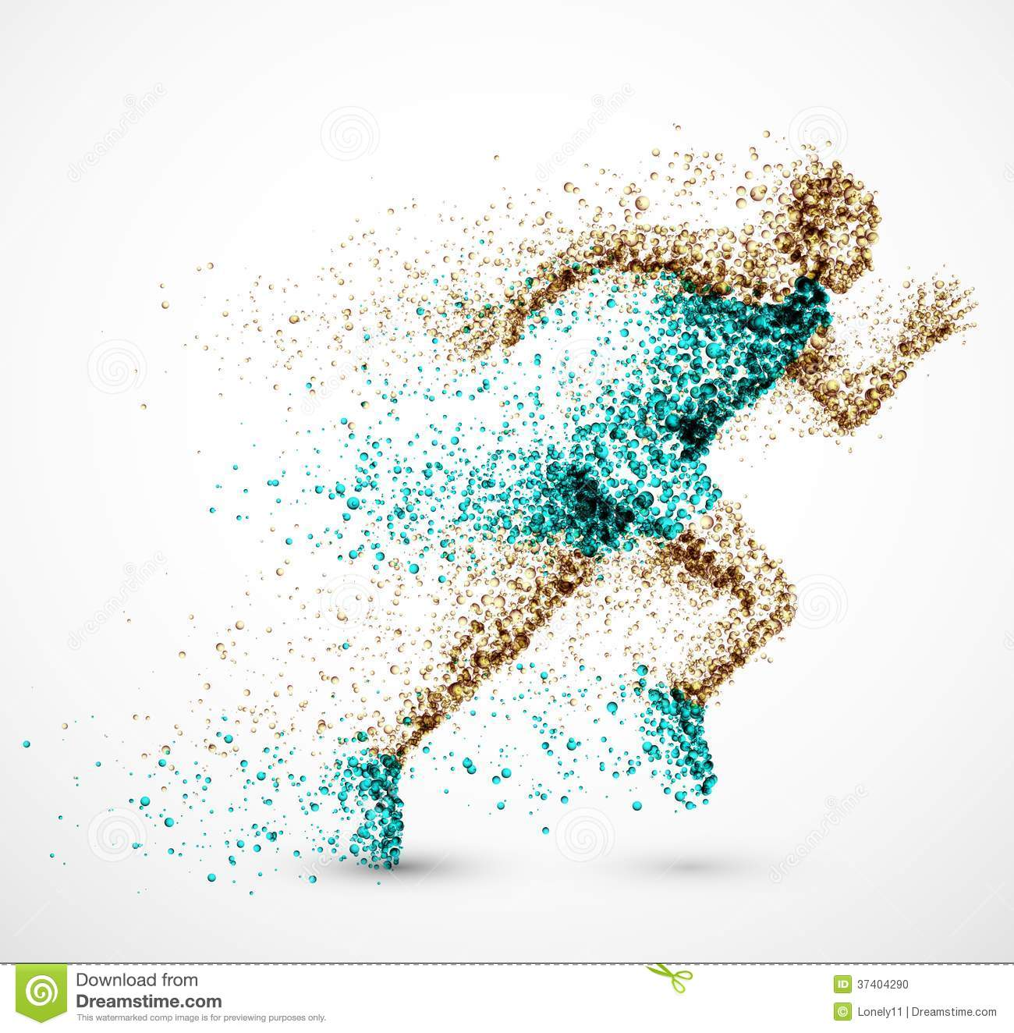
Here are some pictures to explain things.
Adam and Eve before they ate the fruit and got tempted.
If your friends are running on concrete don’t be tempted to do it.
Adam and Eve after they ate the fruit
By Lara W

Slide 51
Click the underlined word to watch a short clip on Temptation.
Click here to see a video
By Lara .W.

Slide 52
Who Tempts Us?
There are lots of people in lives who tempt us to do the wrong thing.​ Some of the main people who tempt us in our lives are friends, enemies, family (siblings), strangers and even Satan (the devil who tried to tempt Jesus). Satan used to be an angel of God’s but then he got jealous and turned evil. Sometimes even though you might think they wouldn’t your friends can tempt you to do the wrong things that you know are wrong but you want to show your friend that you can do the wrong thing. There are different things that happen when Family tempts you. Things can happen with strangers as well especially at the shops, but you have a right to stop yourself from being tempted.
Click here to see the story of Adam and Eve being tempted
By Lara R

Slide 53
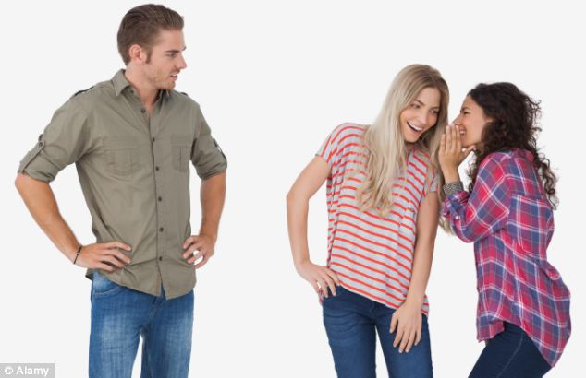
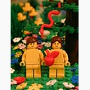
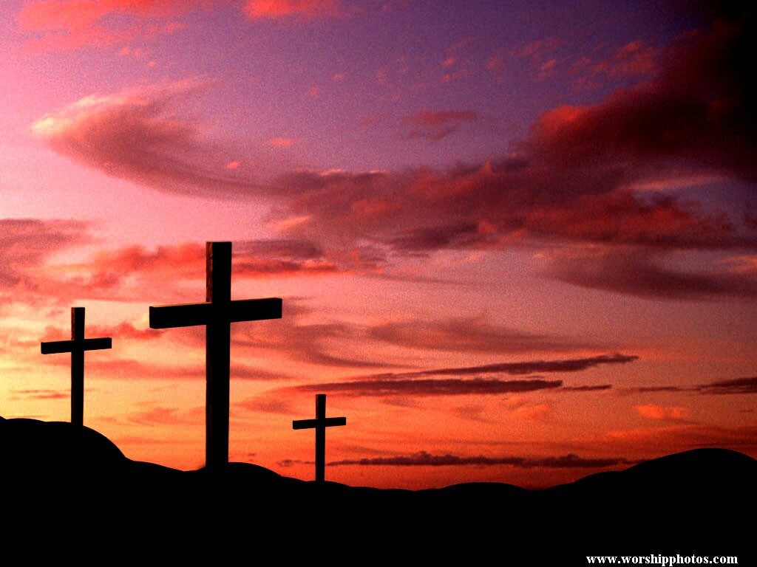
Pictures of people who tempt us in our lives
Friends can make you turn against each other
people can feel left out when this happens
Adam and Eve in The garden of Eden with Satan
People who tempt us:
Strangers
Friends
Family
Satan
We can resist temptation because of Jesus
Dying on the cross for our sins.
By Lara R

Slide 54
Lead us not into temptation
HAVE A GREAT DAY!
Temptation is hard to resist but you are saved by Christ so you can resist the temptation with God’s help!
By Lara R

Slide 55
But deliver us from evil
Oscar. P, Anton and Dillon 5L

Slide 56
THE LORds prayer but deliver us from evil
Oscar.P Dillon.A Anton.A
The lords prayer means “our father”. The part that my team is doing means to do the
right thing and respect
others.

Slide 57
Respecting others is a responsibility to all. Doing wrong is not ok but when it happens you learn from it.
Accusing or dobbing on someone is not nice even if it fells right.. It’s not the right thing to do. This will make you develop a personality. you will do it in less important situations.

Slide 58
Prayer
To help us be protected against sin we need to pray and if we have sinned against others we need to pray to God to forgive us just like Jesus forgave all of us from our sins.
This is someone praying to God to forgive him of his sins and to protect him from sin.

Slide 59
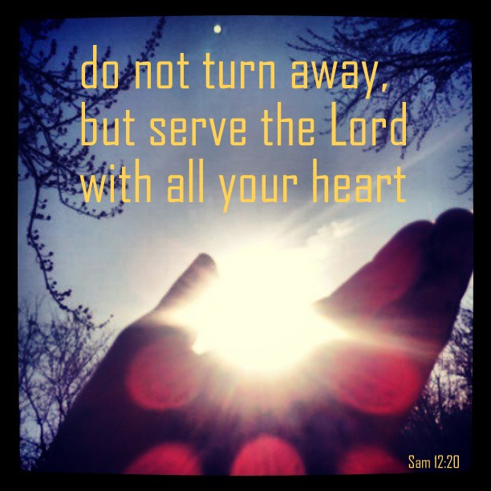
God let us not sin against anyone or anything but gain trust from anyone but forgive us from are sins and give us are rightfulness of gods love and trust. gods trust and love is worth not sinning for join god not against god. thank you for watching

Slide 60
For the kingdom, the power and glory are yours. Amen.
Reefe, Emily and Oscar. O 5L

Slide 61
For the kingdom, the power and the glory are yours now and forever amen.

Slide 62
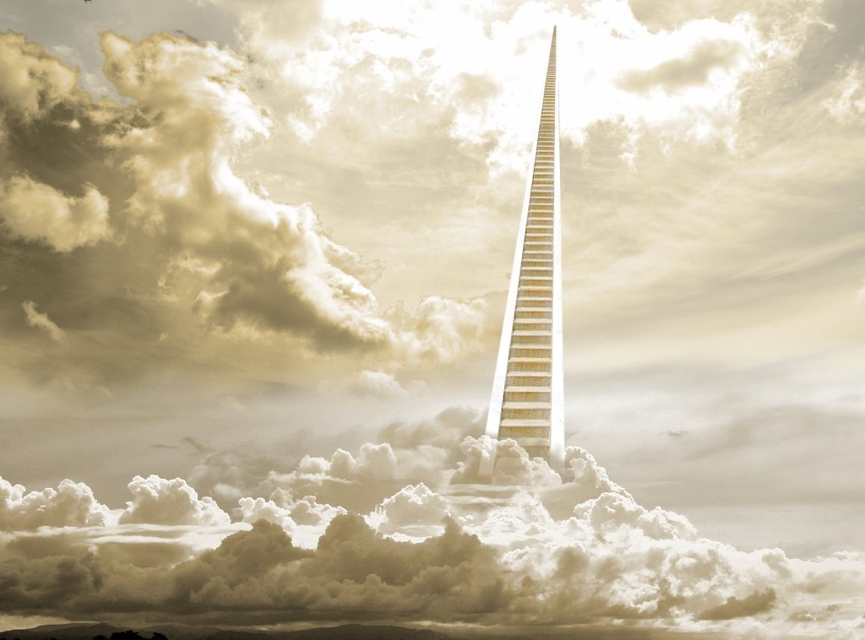
For the kingdom
For the Kingdom means, For Heaven and Earth. We are Earth he is Heaven and he gives our home on earth to do as we shall do and serve God The father God the son God the Holy spirit.

Slide 63
the power, and the glory
Power is the ability to direct people in the way you want. Glory is the honor and the 'alleluia' of praise.

Slide 64
Are yours
'yours' refers to god, because the lord's prayer started with 'our father in heaven'.

Slide 65
Now and forever
Obviously, now means 'this time/moment'. Forever means 'for always'.

Slide 66
Amen
Amen is what we say after we have prayed. What Amen means is (I it will be done..)

Slide 67
Once we say Amen the lord knows we have finished are prayer and we will do as you say.
E.G Lord father let me help my mum relax with all of the cleaning and work she has been doing help me do this in your name AMEN. In this prayer the boy is saying for God to help him relax his mum.

Slide 68
Thanks for watching

